Slide 1
Training LLMs on BIG Scale
Kartik Ramesh, Jimmy Shong, Yiming Su

Slide 2
MegaScale: Scaling Large Language Model Training to More Than 10,000 GPUs
TL; DR
Training LLMs on >10k GPUs is hard
Co-designs algorithm and system
A set of diagnosis tools to monitor system and ID root causes

Slide 3
Introduction & Contributions
Challenges of Training LLM at large scale
High training efficiency?
Increase Model FLOPs Utilization (MFU)
ratio of observed throughput to the theoretical maximum throughput
High training stability?
Aim to reduce recovery time during failures.
Contributions
Algo-system co-design
In-dept observability through event monitoring and visualization techniques
Notes:
test

Slide 4
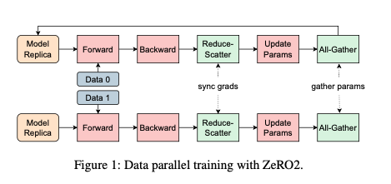
Background
Data Parallelism
Replicas of model states on workers
Evenly distributing training data
ZERO: shards model states across every data-parallel process
Notes:
the traditional all-reduce operations that aggregate gradients are decomposed into sep- arate reduce-scatter and all-gather operations. This is because every data-parallel process retains only a fraction of the total state.

Slide 5
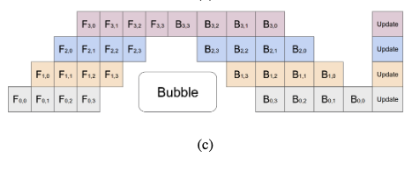
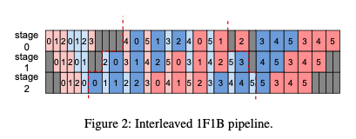
Background
Pipeline Parallelism
Distributes model layers among multiple devices
Divides training batch into micro batches for pipelined execution
3 phases: warm-up, steady, cool-down
Notes:
Similar to CPU pipelining (fetching instructions, decoding, executing, etc).
The first paper on pipeline parallelism on distributed training is GPipe, it trains model in a FIFO fashion, leaving many bubbles. The famous 1F1B pipeline is proposed by the paper PipeDream to eliminate pipeline bubble (no ops).

Slide 6
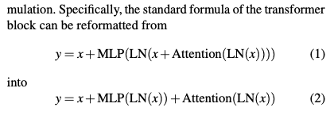
Efficient Training at Scale - Algorithmic Optimizations
Parallel transformer block
Allows parallel computation of attention block and MLP block.
Notes:
Prior work shows that this modification does not degrade the quality of models with parameters in the hundreds of billions.

Slide 7
Efficient Training at Scale - Algorithmic Optimizations
Sliding window attention
Define a sliding window “s” that surrounds each token in the input sequence
Reduce computation when training on long sequence of input.
LAMB Optimizer
Increasing batch size causes bad model convergence
LAMB optimizer allows bigger batch size without compromising accuracy
Notes:
Sliding window instead of full size self attention, more efficient than self attention

Slide 8
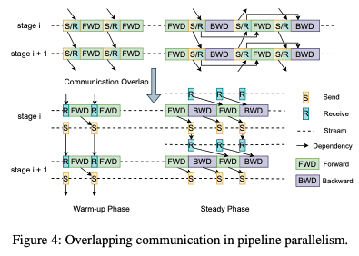
Efficient Training at Scale - Communication Overlapping
Overlapping all-gather
All-gather: gathering model parameters from workers in other ranks during forward pass
Overlapping all-gather with data loading
Overlapping send/receive operations with computation
Data between workers rely on send/receive communications to move between stages
During warm-up, forward pass only rely on previous receive
Decouples send and receive to overlap send with computation
Notes:
During cool-down phase, the same techniques can be applied.

Slide 9
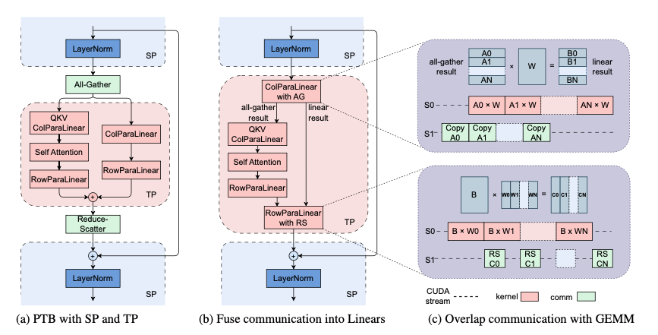
Efficient Training at Scale - Communication Overlapping
Overlapping Linears with all-gather and reduce-scatter
Notes:
Quoting paper:
Tensor parallelism is commonly used to partition weights in computational-intensive operations, while operations like Lay- erNorm and Dropout are partitioned along the sequence di- mension to save GPU memory.
This necessitates all-gather and reduce-scatter operations for input collection and output redistribution across GPUs.
Fusing all-gather and reduce-scatter with Linear layers, improves computation efficiency.

Slide 10
Efficient Training at Scale - Efficient NCCL Group Init
NCCL: NVIDIA Collective Communications Library
High overhead of NCCL initialization with torch.distributed on large scale
Causes & Solutions
In sync step, a barrier operation uses TCPStore, single-threaded, blocking R/W manner
Replacing with Redis improved performance
Incautious usage of global barrier after initializing corresponding communication group
Improved after profiling and debugging
Analyzed network traffic to fine tuned network protocol parameters
Notes:
Quoting paper:
Tensor parallelism is commonly used to partition weights in computational-intensive operations, while operations like Lay- erNorm and Dropout are partitioned along the sequence di- mension to save GPU memory.
This necessitates all-gather and reduce-scatter operations for input collection and output redistribution across GPUs.
Fusing all-gather and reduce-scatter with Linear layers, improves computation efficiency.

Slide 11
Fault Tolerance
Detecting unusual RDMA traffic to alert manual investigation
2-stage approach to fast checkpointing
At each checkpoint, GPU worker first writes on-chip states to host memory
Then asynchronously transfer to a distributed file system (HDFS used in paper)
GPU worker can continue training without waiting for file system writing
Notes:
Some anomalies in the training process may not manifest as explicit errors. We need RDMA traffic metrics as critical indicators
The periodic nature of training tasks should characterize the network traffic in similar temporal patterns.
Any anomalies in RDMA traffic is a signal of potential anomalies. When such anomalies are detected, the watcher alerts for manual investigation. If traffic stops entirely, the watcher triggers fault recovery procedure.

Slide 12
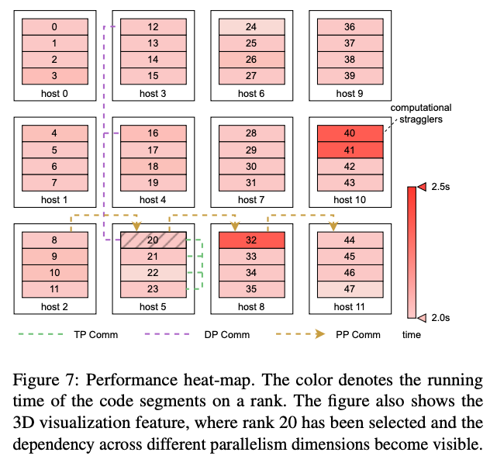
Training Troubleshooting - CUDA event monitor
Heap map of time consumption differences between machines
Traces of events in pipeline parallelism
Notes:
Color: running time of code segments on a rank.
Selecting rank shows different parallelism dependencies.
Also visualization of pipeline parallelism to debug

Slide 13
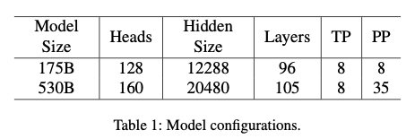
Results
Two configurations of models for testing

Slide 14
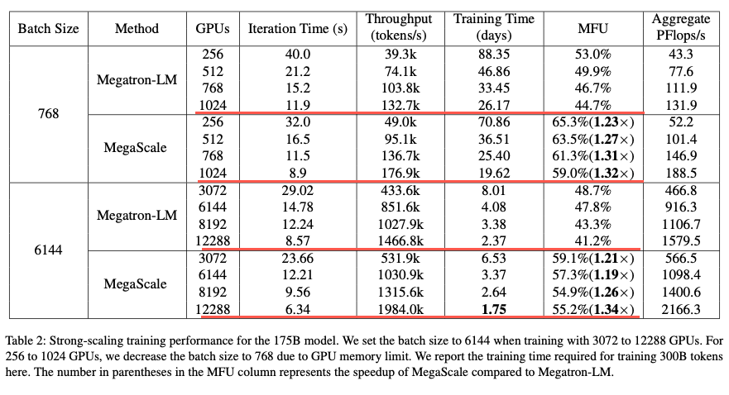
Better MFU compared with Megatron-LM

Slide 15
Lessons Learned
MFU gradually decreases as training goes
Latency increase attributed to NCCL overhead
Some ranks initiates reduce-scatter ops later than others, blocking other ranks
Caused by inefficiencies in code segments and PyTorch operations
Notes:
MFU decrease means less time is spent on utilizing GPU to train

Slide 16
Limitations
Training cluster: heterogeneous training?
Training schedule: asynchronous training?
Reproducibility?
Notes:
No matter how we parallelize the training, we are still training synchronously, and thus some nodes will finish faster than others and some will have to wait for one reason or another.
Can we use it on async training?

Slide 17
Conclusion
Notes:
A co-design of algorithm and system can greatly improve training efficiency and scale of LLM when trained on more than 10,000 GPUs

Slide 18
RDMA over Ethernet for Distributed AI Training at Meta Scale
Motivating Problem:
Increasing computational requirements and scale of AI training workloads.
Coordination of thousands of GPUs at high bandwidth, high utilization, low latency.
Notes:
Mention that a few classes back we saw how Meta trained the Llama3.1 herd of models. This used 16K H100 GPUs.

Slide 19
Remote Direct Memory Access over Converged Ethernet
GPU communication over the network using sockets involves the CPU and is slow.
RDMA allows accessing memory without involving the CPU.
RoCE enables RDMA over an Ethernet network using specialized NICs.

Slide 20
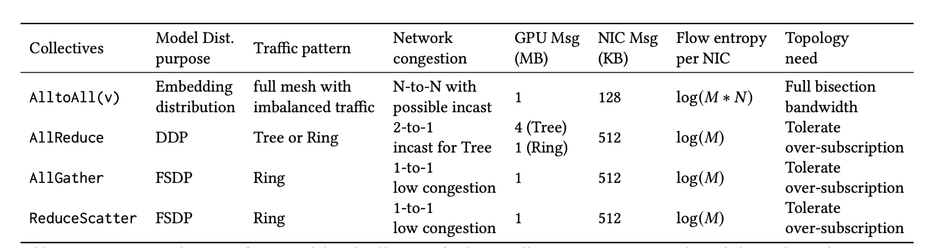
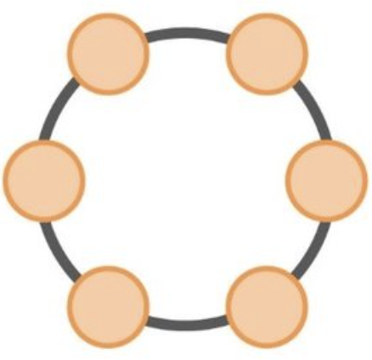
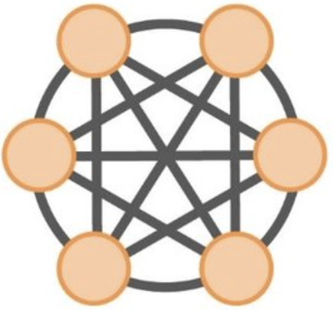
Traffic Patterns in Distributed Training
Low entropy of traffic.
Congestion varies greatly with job type.
Notes:
Distributing training on multiple GPUs results in collective communication patterns which can create congestion and slow down training if not handled appropriately.
Llama 3.1 for example makes use of FSDP and DDP internally.
The parallelism type controls the collective used, which controls the traffic pattern choice.
The traffic pattern controls the network topology required.
NCCL translates collective communication into a logical topology, followed by point-to-point transactions between GPUs.

Slide 21
Challenges
Evolution
Entropy
Different workloads resulting in different congestion patterns

Slide 22
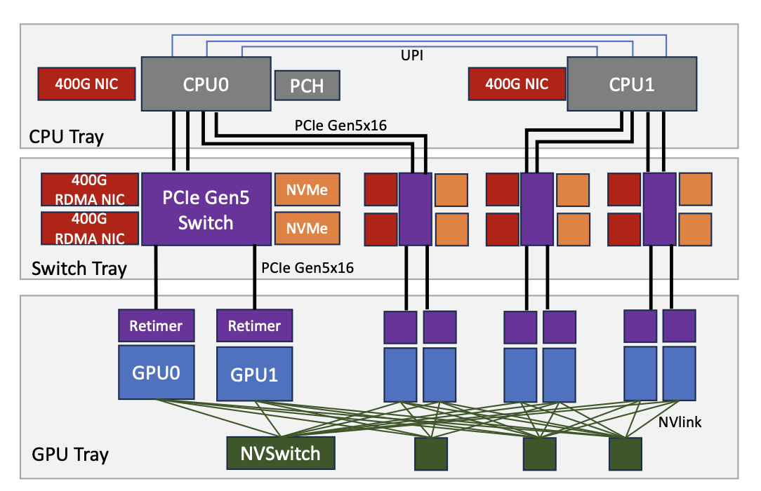
Network Topology - Training Node
Each node contains 2 CPUs, and 8 GPUs.
2 CPU NICs (one for each CPU) and 8 RDMA NICs (one for each GPU).
GPUs are fully-meshed between each other using NVLink and NVSwitch.

Slide 23
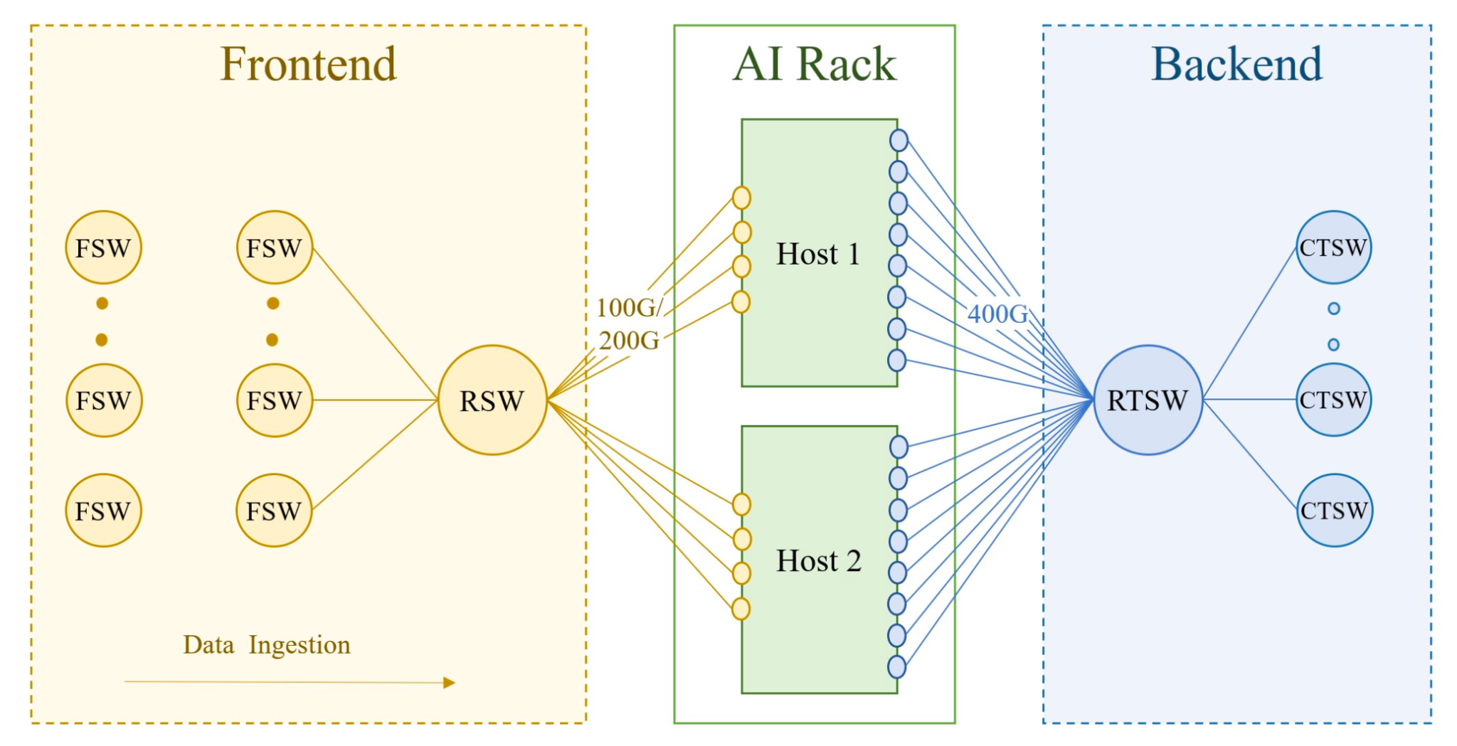
Network Topology
Front End: Connects to the storage warehouse
Back End: Connects all GPU RDMA NICs
Notes:
The reason they came up with this split was because their requirements for GPU-GPU communication was scaling at a much higher rate than demands for ingestion.

Slide 24
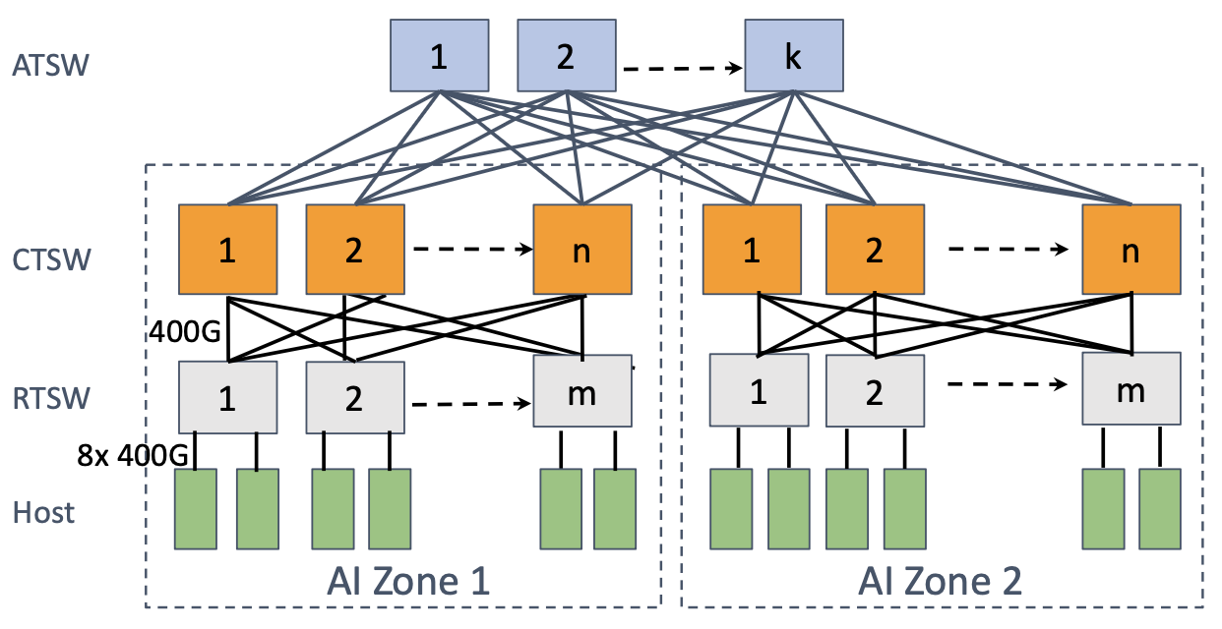
Backend Network Architecture
ToR Architecture
2 servers per rack connected by RTSW
AI Zone
Upto 18 CTSW, 192 Racks, ~4000 GPUs.
Deep buffer switches to enable cross rack communication.
Full bisection bandwidth.
DC Scale
ATSW connects up to 8 AI Zones.
Provides oversubscribed bandwidth.
Large jobs with collectives suitable are placed.
Scheduler spreads job with Network topology awareness.
Notes:
Oversubscription allowed due to hierarchical collectives.
Extensible because you can add more layers on top, or extend existing layers.

Slide 25
Network Routing
Characteristics of AI training workloads
1. Low Entropy: The number and diversity of AI workloads is smaller and predictable.
2. Burstiness: Flows exhibit an "on" and "off" nature, causing transient congestion.
3. Elephant Flows: Few flows that contribute to really heavy traffic.
These characteristics prevent Static Routing and traditional ECMP approaches.

Slide 26
Enhanced ECMP
Split GPU communication using QP Scaling.
Use customized ECMP hashing algorithm to use QP field.
GPU 1
GPU 2
NIC
QP 1
QP1
NIC
QP2
QP2
Notes:
QP scaling increases entropy in the network, since 1 flow gets converted into multiple flows.
We make use of this entropy by including QP ports in the ECMP hash.

Slide 27
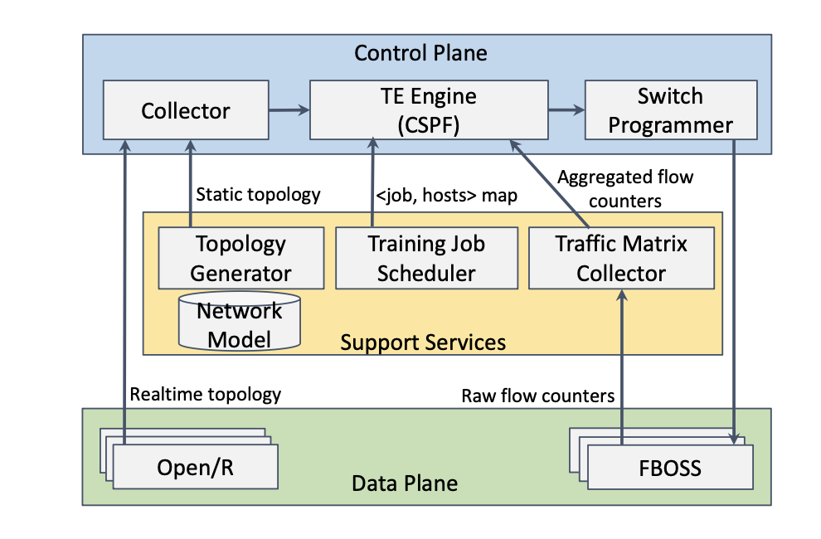
Centralized Traffic Engineering
Use static + live topology, live flows and job-host mappings to dynamically route flows every 30s.
TE outperforms E-ECMP in bandwidth utilization for collectives.
However, lower utilization in the presence of failures, software complexity and overhead.
Notes:
They tried to find a non-deterministic approach by implementing Traffic Engineering.
They implemented TE in their ranking clusters, but not for their DC wide AI clusters.

Slide 28
Transport

Slide 29
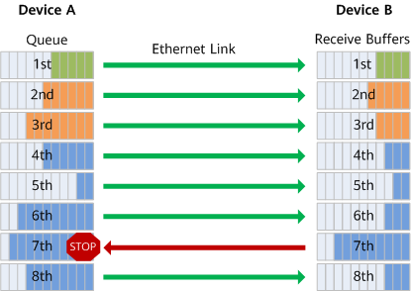
Background - Priority Flow Control (PFC)
Notes:
A mechanism that prevents packet loss in networks when congestion occurs in high-priority traffic like storage or real-time communication, where the downstream device instructs the upstream device to stop sending traffic in the queue, implementing zero packet loss and creating a lossless queue
As shown in the figure, eight priority queues on the transmit interface of Device A correspond to eight receive buffers on the receive interface of Device B. When a receive buffer on Device B is congested, Device B sends a back pressure signal "STOP" to Device A, requesting Device A to stop sending traffic in the corresponding priority queue.
PFC addresses the conflict between the Ethernet Pause mechanisms and link sharing. It controls traffic only in one or several priority queues of an interface, rather than on the entire interface.
What's more, PFC can pause or restart any queue, without interrupting traffic in other queues. This feature enables traffic of various types to share one link.
Uses IEEE 802.1Qbb standard to apply flow control based on traffic class or priority level (identified by VLAN tags in layer 2).
Challenges: However, untagged traffic—traffic without VLAN tagging—cannot be examined for IEEE 802.1p code points on which to pause traffic, and we are interested in using PFC for layer 3 which is the network layer

Slide 30
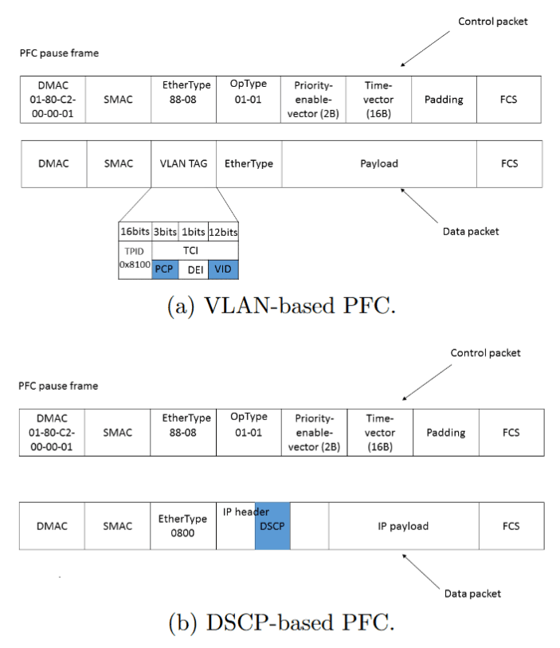
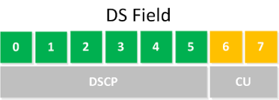
Background - DSCP-Based PFC
Notes:
Instead of using VLAN tagging in layer 2, we use DSCP tagging in Layer 3
Differentiated Services Code Point (DSCP) is a means of classifying and managing network traffic and of providing quality of service (QoS) in modern Layer 3 IP networks.
It uses the 6-bit Differentiated Services (DS) field in the IP header for the purpose of packet classification.
Challenges: While PFC helps avoid congestion drops, hop-by-hop PFC propagation during persistent congestion can created persistent Pause Frames, leading to head-of-line (HoL) blocking where paused lower-priority traffic can block higher-priority flows creating flow unfairness and poor performance.

Slide 31
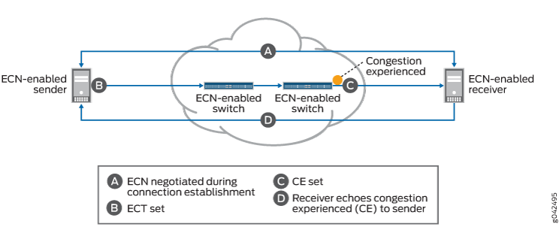
Background - Explicit Congestion Notification
Notes:
Instead of dropping packets to signal network congestion, ECN marks packets to signal network congestion, without dropping the packets.
Uses two bits in the IP header (ECN field) to signal congestion: packets are marked by routers or switches when congestion is detected, and endpoints reduce their sending rate accordingly.
ECN serves as a more granular end-to-end congestion management technique, signaling the sender to reduce data transmission rates upon detecting potential congestion.
Challenges
Requires end-to-end support across all devices in the network path (routers, switches, endpoints) for full effectiveness, which can limit deployment in some environments.

Slide 32
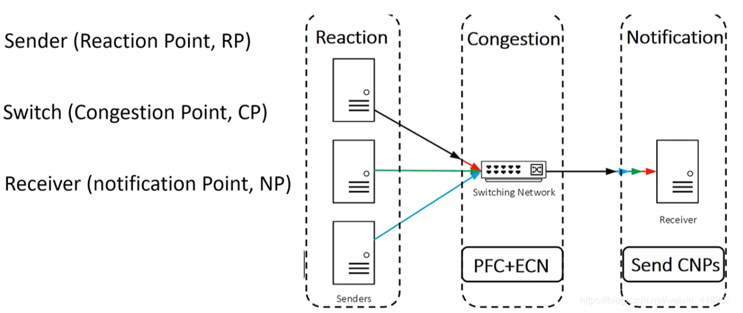
Background - DCQCN
Notes:
Data Center Quantized Congestion Notification (DCQCN) is a combination of ECN and PFC to support end-to-end lossless Ethernet.
ECN helps overcome the limitations of PFC to achieve lossless Ethernet.
The idea behind DCQCN is to allow ECN to do flow control by decreasing the transmission rate when congestion starts, thereby minimizing the time PFC is triggered, which stops the flow altogether.
The correct operation of DCQCN requires balancing two conflicting requirements:
Ensuring PFC is does not trigger too early, that is, before giving ECN a chance to send congestion feedback to slow the flow.
Ensuring PFC is does not trigger too late, thereby causing packet loss due to buffer overflow.
Previously SOTA method to manage momentary congestion in RDMA deployments

Slide 33
Limitations of DCQCN
Tuning DCQCN is challenging
Tighter ECN thresholds reduce the buffer at the cost of performance in corner cases
Relaxed ECN thresholds produce marginal performance benefit at the cost of worst case congestion and queue buildup
Limited effectiveness due to NCCL’s control loop that limits network traffic
These two control loops do not account for each other
New DCQCN firmware for 400 Gbps Networks introduced bugs
Notes:
Quickly noticed that DCQCN for collectives did not scale well
Either would able reduce the buffer at the cost of performance in corner cases
Or produce marginal performance benefit at the cost of seeing very large buffer thresholds
The limited effectiveness of DCQCN is due to the fact NCCL itself has a control loop that limits the amount of traffic hosted on the network
two controls loops both operating from the sender's perspective without accounting for each other
On top of this, when upgrading to 400G network, there were bugs in the vendor's DCQCN implementation
Decided to just use PFC and NCCL

Slide 34
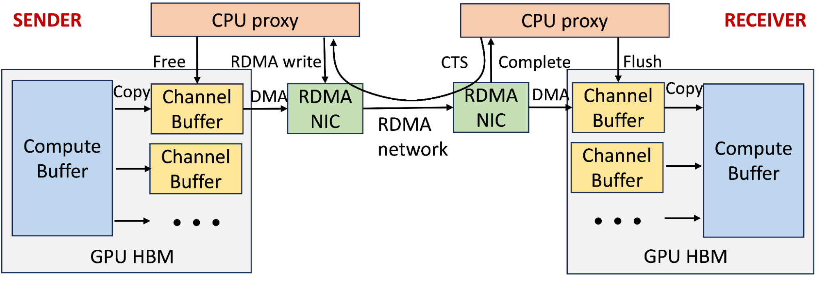
Receiver-Driven Traffic Admission via Collective Library
Notes:
• GPU-to-GPU communication architecture uses two-stage copy and receiver-initiated communication via NCCL collective library.
• High Bandwidth Memory (HBM) on each GPU maintains multiple channels for parallel transmission of chunked collective messages.
• Sender GPU threads copy data from compute buffer to an available channel buffer.
• Sender CPU proxy thread posts an RDMA write request after receiving a clear-to-send (CTS) packet from the receiver, which includes size and memory details.
• Receiver GPU threads copy the channel buffer contents to the destination compute buffer.
• CPU proxy threads on both sides recycle the channel buffer.
• Receiver CPU proxy thread sends another CTS packet when the channel buffer is ready for reuse.
• Receiver-driven traffic admission helps limit in-flight traffic, particularly during network congestion.
Hence, when a network is congested, slowing down a receiver completions ultimately slow down the rate of traffic being posted on the network, especially by the sender due to the slow CTS feedback

Slide 35
Receiver-Driven Traffic Admission via Collective Library
Receiver-driven traffic admission limits in-flight traffic during congestion.
Challenges in configuration
Limited channels due to GPU resource contention.
Channel buffer size balance between congestion and bandwidth use.
Two steps for improved performance
Tuned number of channels and channel buffer size based on training job sizes and collective types.
Added high priority queuing at switches for CTS packets to prevent bandwidth starvation.
Notes:
Configuring the right settings can be challenging due to:
Limited number of channels caused by resource contention between GPU threads and concurrent compute operations.
Balancing channel buffer size requires careful consideration to avoid congestion spreading or bandwidth under-utilization.
RoCE’s coarse-grained flow control and potential end-host slowness make this balance more complex compared to Infiniband.
Two steps for improve performance
Experimentally determined the right parameter settings for the number of channels and channel buffer size across various training job sizes and collective types.
implemented high priority queuing at switches for CTS packets to expedite the notifications and mitigate potential bandwidth starvation

Slide 36
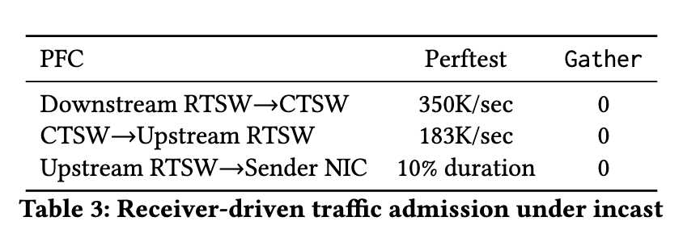
Experiment
Setup
16:1 incast experiments conducted on a 400G network with PFC enabled.
Compared Perftest and NCCL Gather collective
Results
Perftest showed HoL blocking, with CTSW absorbing congestion but not preventing back pressure.
No back pressure in the CTSWs was observed in the Gather collective test
Notes:
To demonstrate the effectiveness of this mechanism, we conducted 16:1 incast experiments on our 400G network with only PFC enabled
Compared a streaming traffic generator Perftest and a recurring NCCL Gather collective test.
Although Gather collective is rarely used in our production training, it generates the most severe incast among other collectives, stressing the system mechanism.
Both tests ran for five minutes, producing 16:1 incast with the same traffic volume.
Observed Head of Line blocking in perftest.
The deep buffer in the CTSW absorbed a significant amount of congestion, but not enough to prevent back pressure from reaching the sending NICs.
However, no PFC back pressure was observed in Gather collective case.

Slide 37
Absorbing In-Network Congestion
2-stage Clos architecture used for AI zone.
Deployed RTSWs with shallow buffers and CTSWs with deep buffers
Deep buffers were carved per port to absorb congestion and reduce HoL blocking.
Non-blocking architecture with high-radix spine switches adds a safety layer to minimize congestion.
Notes:
AI zone is built on a 2-stage Clos architecture
While they used switches with shared and shallow buffer architecture for the RTSWs, they used CTSWs with deep buffers.
They leveraged these large buffers by statically carving them per port on the ingress.
This large per-port buffer helped absorb any ephemeral congestion and ensured a port facing back pressure to reduce HoL blocking across ports.
Given the high radix of our spine switches, we considered this nonblocking architecture an additional safety layer towards minimizing congestion.
Carving
“statically carving them per port on the ingress” refers to allocating a fixed portion of the available buffer memory to each port of the switch on the ingress side (the side where data enters the switch).
Essentially, it means that the total buffer space in the switch is divided and dedicated to individual ports, ensuring that each port has its own reserved amount of buffer space.
By statically carving (or partitioning) the buffers this way, the system can better handle transient (ephemeral) congestion by preventing one congested port from consuming all available buffer space, which could negatively impact other ports.
This strategy helps manage back pressure and minimizes head-of-line (HoL) blocking, a condition where a congested port can prevent the forwarding of packets for other, non-congested ports.
Radix
The radix of a switch refers to the number of input/output ports it has. It represents the degree of connectivity of the switch—essentially, how many other devices or switches can be connected to it.

Slide 38
Implementation Details
Support GPUDirect using Linux inbox drivers
Uses DSCP-based PFC across switches and NICs to prevent Layer 3 packet drops
Go-back-N re-transmit mechanism for rare packet drops due to unhealthy network elements or link issues
Quick detection of unhealthy network elements and tuning LAT are crucial for predictable training performance.
Packet drops on ACK/NACK can lead to prolonged Local ACK Timeout (LAT)
Notes:
The team implemented multiple configurations to achieve high bandwidth, low latency, and predictable latency in their RoCEv2 setup, which is crucial for efficient distributed trainin
They worked with Network Interface Card (NIC) vendors to support GPUDirect (a technology that allows GPUs to communicate with NICs directly) using Linux inbox drivers. This approach improves manageability of the software stack, ensuring smoother integration and better performance when managing distributed training workloads.
DSCP (Differentiated Services Code Point)-based Priority Flow Control (PFC) is used to ensure high-priority traffic (like the data in distributed training) is handled carefully. They utilized a single lossless queue across all switches and NICs in the network. This means packet drops are avoided at Layer 3 (network layer), ensuring a stable and reliable network for distributed training.
For rare packet drops (due to network issues like unhealthy elements or link problems), they used a go-back-N retransmission mechanism. This mechanism helps recover from lost packets by retransmitting starting from the first lost one.
However, packet drops on acknowledgement packets (ACK or NACK) can cause prolonged Local ACK Timeout (LAT) on the order of milliseconds.
Therefore, quickly recognizing and isolating unhealthy network elements and links and carefully tuning LAT duration, are important for predictable training workload performance.

Slide 39
Experiences

Slide 40
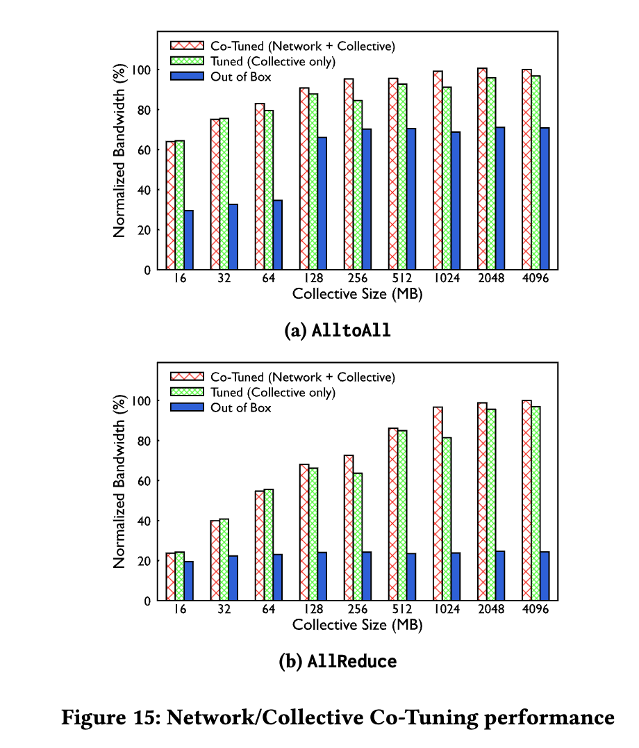
Co-tuning NCCL
NCCL shows sub-optimal performance out-of-the-box
Assumptions from the developer environment
very low RTT latency
an adaptive routing mechanism
a non-blocking topology without over-subscription
Led to sub-optimal architectural choices in developer environments
NCCL adapts to server topology but lacks awareness of network topology by default.
Notes:
We observed NCCL may deliver sub-optimal out-of-the-box performance due to the difference of the developer’s environment vs. our production environment.
Some of the assumptions from the developer environment include
very low RTT latency,
an adaptive routing mechanism,
a non-blocking topology without over-subscription.
Those assumptions are shown in sub-optimal choices across the architecture, including
a two-stage copy in posting smaller messages;
a receiver-initiated architecture that relies on control messages (CTS) in the critical path
limited logicaltopology choices that accumulate latency at large gangs, e.g., Ring for AllGather.
In terms of adaptability, NCCL used in our production environment learns and adapts to server topology, but it has no default awareness of network topology.

Slide 41
Co-tuning NCCL - continued
Higher unloaded RTT led to tuning message sizes and channel buffer size to ensure more outstanding data on the network
For latency-sensitive collectives, increasing message and buffer sizes improved performance.
Increasing the QoS priority of CTS and ACK packets reduce delay from 43 us to 4 us
Notes:
Higher unloaded RTT
In production, researchers observed higher unloaded RTT ( 22𝜇s) due to CTSW switches using a Virtual Output Queuing (VOQ) architecture
hence requiring credit information exchange from egress to ingress queue.
This high latency necessitated tuning the message size posted to be larger as well as ensuring more outstanding data on the network.
This involved tuning channel buffer size and message size that is posted to the network to be just large enough to achieve optimal performance.
For latency-sensitive collectives like AllGather, ReduceScatter, increasing the message size as well as interim buffer size improved performance.
Rendezvous message performance impact
The Receiver-driven communication architecture relies on rendezvous messages such as Clear to Send (CTS) and Acknowledgements (ACK).
In production, researchers observed that congestion buildup has delayed these messages on the return path.
Researchers instrumented NCCL to measure the average delay the sender is waiting for such packets.
Researchers reduced this delay from P90 of 43 𝜇s to 4 𝜇s.
For ACK packets, we used RTSW ASIC features to modify the DSCP marking to land them in a different priority.

Slide 42
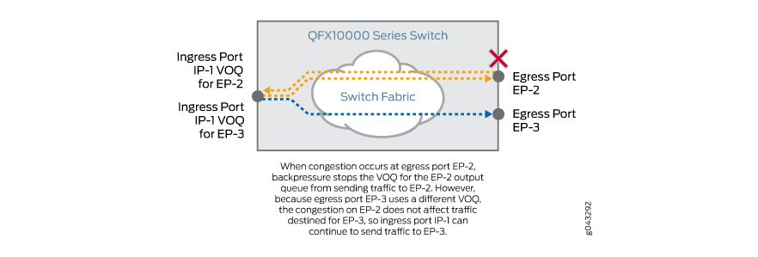
Co-tuning NCCL - continued
For smaller or medium collective sizes, tweak NCCL to choose logical topologies and protocols used at larger collective sizes than the default
Posting larger messages helps reduce the number of CTS and completion messages.
Used credit allocation, with high initial allocation and ramp curve of credits, to reduce RTT latency from CTSWs utilizing VOQ architecture
Notes:
Small messages
NCCL accounts for optimal performance for small collective sizes by following 2 strategies
Different logical topologies to implement the same collective, e.g., Tree vs Ring
Different low-latency or high-bandwidth protocols, e.g., Simple, LL128, LL (low latency), to deal with memory barriers when crossing GPU memory to the PCIe / RDMA boundary or vice-versa.
Each topology or protocol may be optimal for smaller or larger collective size.
However, the tuning of when to use a particular logical topology or protocol is calculated by a static tuning model that assumes low fabric latency (both loaded and unloaded).
This results in unfavorable trade-offs and poor performance.
Our strategy to achieve optimal performance at smaller or medium collective size is to tweak the tuning algorithm to choose recursive logical topology (Tree) or one that posts larger messages on the network (Rail-based Alltoall) as well as protocols (LL128) at larger collective sizes than the default NCCL choice.
Posting larger messages helps reduce the number of CTS and completion messages.
CTSW Latency
While the above tuning and changes ensure the collective performance is optimal for our baseline RTT, they also reduced the RTT from CTSWs that leverage a Virtual Output Queuing (VOQ) architecture.
This involved tuning a more aggressive credit allocation from egress to ingress port, both in terms of initial allocation as well as the ramp curve of credits.
For hierarchical collectives specifically that are latency-sensitive, we noticed up to 15% performance improvement for small sizes.
QnA
Initial allocation of credits: Credits represent the amount of data that can be sent from the egress port to the ingress port without causing congestion. The initial credit allocation is the amount of buffer space or bandwidth assigned to the ingress port when a communication link is first established. By making this more aggressive, the system allows more data to be sent right from the start, potentially improving performance but with a risk of congestion.
Ramp curve of credits: The ramp curve describes how quickly additional credits are granted over time as more data is sent. A more aggressive ramp curve means that credits are granted faster, allowing data to flow more quickly, which reduces delays. This is important for latency-sensitive applications where rapid data transmission is crucial.
VOQ (Virtual Output Queue) architecture is a queuing mechanism used in network switches and routers to efficiently manage traffic and prevent congestion
Solves HoL blocking by having each input port maintains multiple virtual queues, one for each output port.
When data arrives at an input port, it is placed in the appropriate queue that corresponds to its intended output port.
The switch or router schedules the data transmission based on these queues and sends data when the output port becomes available.

Slide 43
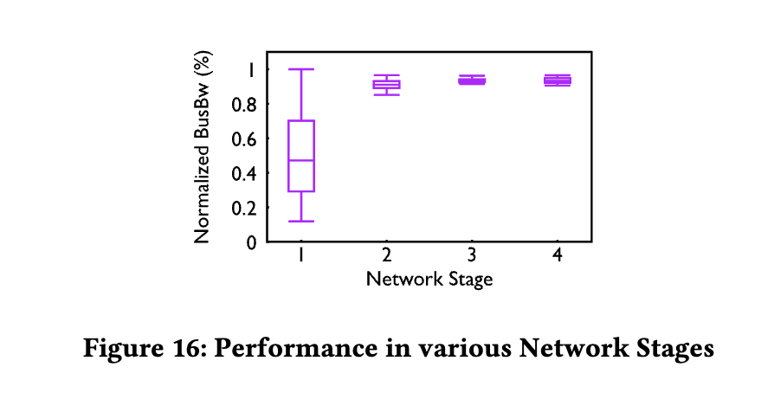
Impact of Routing and Topology
Stage 1: 1:1 subscription ratio (RTSW-to-CTSW) with static routing
Stage 2: 1:2 under-subscription
Perf increase for 2x network infrastructure investment.
Stage 3: Introduced traffic engineering
Stage 4: 1:1.125 under-subscription to reclaim CTSW hardware without perf loss.
Notes:
the evolution ofa ZionEX 200G based AI zone through stages over time, from a routing and topology perspective.
Figure 16 depicts the performance of each stage (time period) over tens of thousands of jobs run over years, quantified by normalized AllReduce collective bandwidth[24].
The Stage 1 Backend Network has a topology with 1:1 subscription ratio from RTSW-to-CTSW
Stage 2 has a topology with 1:2 under-subscription.
Both Stage 1 and Stage 2 use static routing with traffic collisions.
We observe a significant performance increase with additional capacity when migrating from Stage 1 to Stage 2.
The lower and inconsistent performance in Stage 1 is attributed to the static routing traffic collisions as described earlier.
While the performance impact was resolved with Stage 2’s under-subscription, the solution came with investing 2x network infrastructure.
Stage 3 shows performance when we migrated our network setup to be controlled by the traffic engineering while keeping under-subscription to 1:2.
You can observe similar performance with Stage 2 but with a tighter band.
In Stage 4, we further reduced under-subscription ratio to 1: 1.125 to reclaim CTSW hardware without any negative impact to performance.
We didn’t reduce the under-subscription all the way to 1:1 in order to allow for buffer for up to two link failures.

Slide 44
Observability Tools - Job-Facing Network Errors
RDMA is very sensitive to network issues
Built telemetry systems to automatically collect RDMA hardware counters across the network switch, NIC, PCIe switches and GPUs
Identified 3 important counters to identify network issues
OOS: The number of packets out of sequence as perceived by the NIC
Link flap counters: hardware and software link flaps reported by the NIC
LAT: The number of times a Queue Pair’s ACK timer expired for QPs at the sender side
Notes:
RDMA is very sensitive to network issues and hence it affects GPU training efficiency.
In order to quickly examine the RDMA network condition behind a training workflow, researchers built telemetry systems to automatically collect RDMA hardware counters across the network
We identified three important counters to identify network issues: (1) Out-of-Sequence (OOS): The number of packets out of sequence as perceived by the NIC.
This helped identify and root-cause many instances of packet drops due to unhealthy network switches as well as NIC hardware bugs.
There were instances of packet drops not reported anywhere else, but this transport metric showed the existence of the problem.
Link Flap Counters: This can indicate both hardware and software flaps reported by the NIC.
link flapping refers to the frequent up-and-down state of a physical link.
Local Ack Timeouts (LAT): The number of times a Queue Pair’s ACK timer expired for QPs at the sender side.
Expiration can impact performance regressions and on occasion job failures.
With RoCET, these counters are directly reported to users when their jobs fail and serve as a strong indication that some components within the network may be misbehaving.

Slide 45
Observability Tools - Operator-Facing Network Errors.
Safeguard mechanisms for detecting anomalies and automated mitigation
PFC Watchdog
Enabled on both RTSW and CTSW devices to catch any long-duration PFC pause
Buffer thresholds and Congestion Drops
Monitoring around buffer utilization on RTSW devices and packet drops due to congestion
Alarms are raised if buffer utilization goes beyond 80%
Reachability
in-house tools periodically checking for the health and connectivity by sending pings to various nodes
Notes:
Researchers have safeguard mechanisms built into the network where they not only monitor and detect anomalies but also perform automated mitigation to fix many of these issues.
PFC Watchdog
This is enabled on both RTSW and CTSW devices to catch any long-duration PFC pause (>200ms) which could be because of deadlocks or a bad NIC which continues to send PFC frames.
Buffer thresholds and Congestion Drops
They have monitoring around buffer utilization on RTSW devices.
Alarms are raised if buffer utilization goes beyond 80% which points to either persistent congestion or a bug.
In practice, they have not breached this threshold.
They also monitor packet drops due to congestion. Since we have a lossless network, these drops are uncommon and observed mostly due to misconfiguration.
Reachability
They have several in-house tools periodically checking for the health and connectivity of the fleet by sending pings to various nodes to detect either aliveness or abnormal loss and delay in the network.

Slide 46
Troubleshooting Examples - Performance Baseline
Operating RoCE networks is complex
Observed performance regression detected during a cluster turn-ups.
No congestion metric anomalies
Only difference was the software image version in the CTSWs.
After downgrading the image to baseline, the performance returned.
A change in the internal packet scheduling which led to a higher port-to-port latency for that device vendor.
Showcases the need for constant monitoring of loaded and unloaded latency
Uses a mix of synthetic traffic generation and library instrumentation to establish a baseline.
Notes:
Researchers observed a performance regression detected during one of our cluster turn-ups.
They found no congestion metric that they were monitoring that was out of the baseline.
Further investigation revealed that the only difference was the software image we had in our CTSWs.
After downgrading the CTSW images to be the same as the one used in the baseline, the numbers aligned again.
After talking to the vendor, it was highlighted that there was a change in the internal packet scheduling which led to a higher port-to-port latency for that device.
This incident showcased the need for constant latency monitoring in backend networks, both loaded (with congestion) and unloaded (when the network is not saturated).
They now use a mix of synthetic traffic generation and library instrumentation to capture this and establish a baseline.

Slide 47
Troubleshooting Examples - Performance Baseline
Observed CTSWs reporting traffic drops in a cluster migrated to support integration of traffic engineering controller
Cause: an outdated assumption about the SRAM buffer size in the CTSW led to tail-drop of traffic when more than half of the buffer was populated.
The overflowing of the SRAM buffer occurred when
a firmware upgrade that enabled more aggressive RoCE packet transmission
a training job with bursty traffic pattern
the introduction of H100 GPUs with greater computing resources and higher I/O requirements.
showcased the importance of thorough checks before deploying change due to dynamic nature of jobs
Notes:
observed several CTSWs reporting RoCE traffic drops in a training cluster which tehy migrated to support the integration of the TE controller.
Migration consisted of: reconfiguration of the CTSWs, changes in the QoS settings, routing changes in the RTSWs, and PCIe credit upgrade for NIC.
Only a few switches reported traffic drops post migration, but the aggregate drop volume was enough to disrupt some jobs.
Upon investigation, we traced the problem to an intricate interaction of multiple parallel events.
The primary cause of the drop was a bug from an outdated assumption about the SRAM buffer size in the CTSWs, which led to tail-drop of traffic when more than half of the buffer was populated.
The overflowing of the SRAM buffer only occurred under a certain combination of aggravating factors:
a firmware upgrade that enabled more aggressive RoCE packet transmission,
a training job with bursty traffic pattern
the introduction of H100 GPUs with greater computing resources and thus higher I/O requirements.
This incident showcased the importance of thorough validation and performance regression checks before deploying changes. It is important to note that in the problem space of RoCE for AI training jobs, we must contend with the dynamic nature of training jobs.
A significant portion of training jobs is experimental, so predicting traffic patterns and therefore conducting thorough end-to-end testing is challenging.
This incident emphasized the importance of having effective detection and alerting systems to quickly identify and respond to issues.

Slide 48
Limitations
Issues that come with synchronous training such as straggler effect
Requires a lot of manual tuning to get the NCCL to properly reduce congestion
Using RoCE networks is incredibly complex
Deep buffer switches make scaling more difficult
No generalized routing solution that is operationally simple
The RTT latency of the system is high, making scaling difficult

Slide 49
Related Works
Deployment experience of RDMA networks
Congestion control: HPCC
Reliability: Tagger
Performance Isolation: Justitia
Improving networks for AI
New network topologies: Rail-Only, TopoOpt
Accelerate collective communication using bandwidth: Mscclang, TACCL
BytePS
Networks and AI co-design
Co-design: TPUv4, Neo
Automated model parallelism: Unity, Alpa

Slide 50
Conclusion
ToR topology with 3 layer Clos helps support scalability, extensibility, and reliability
Enhanced ECMP and TE deal with persistent congestion caused by inefficient load balancing
NCCL and statically carved buffers deal with momentary congestion
Roofline performance can be achieved by NCCL co-tuning
Notes:
The design and operation of large-scale RoCE networks for distributed AI training workloads have evolved to meet the increasing demands of computational density and scale.
By segregating Frontend and Backend networks, employing various routing schemes, and optimizing collective traffic patterns, researchers have managed to build a performant and reliable network infrastructure.
These designs and insights underline the importance of deeply understanding the training workload and translating these implications into network component design, ultimately contributing to the advancement of distributed AI training infrastructure.

Slide 51
If we have time

Slide 52
Gemini: Fast Failure Recovery in Distributed Training with In-Memory Checkpoints
Motivating Problem:
Failures are frequent in ML training
OPT-175B: 100+ failures in 2 months
We desire a higher checkpointing frequency
Following slides are made by paper authors
Notes:
Mention that a few classes back we saw how Meta trained the Llama3.1 herd of models. This used 16K H100 GPUs.

Slide 53
Checkpoint for failure recovery
How checkpoint works?
Periodically checkpoint the model states
Resume from the latest checkpoint
Redo the computation
Time
Checkpoint
Remote storage
4

Slide 54
Checkpoint for failure recovery
How checkpoint works?
Periodically checkpoint the model states
Resume from the latest checkpoint
Redo the computation
X
Failure
Time
Checkpoint
Wasted time
Desire higher checkpoint frequency

Slide 55
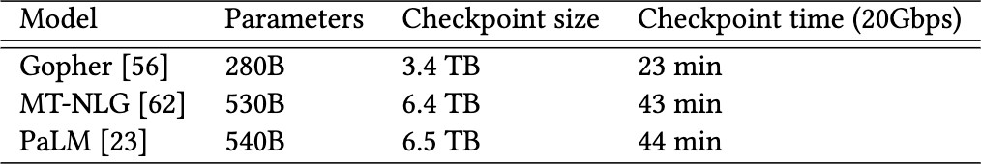



Checkpoint in LLM
Limited checkpoint frequency
Checkpoint to remote storage takes a long time
Checkpoint frequency is limited by the checkpoint time
¹⁰⁰ 200 300 310 ²⁰⁰
Iteration
Failure
Checkpoint
Retrieval
ckpt 1
ckpt 2
ckpt 3
ckpt 2
Wasted time
Time

Slide 56
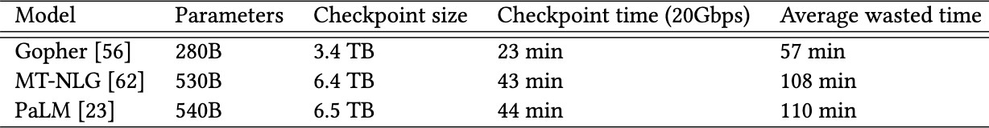
Checkpoint in LLM
Prohibitive failure recovery overhead
Costly wasted time
Even with the highest checkpoint frequency
Significant GPU resources are wasted due to failure recovery
Thousands of GPUs involved
Hundred of failure during training

Slide 57
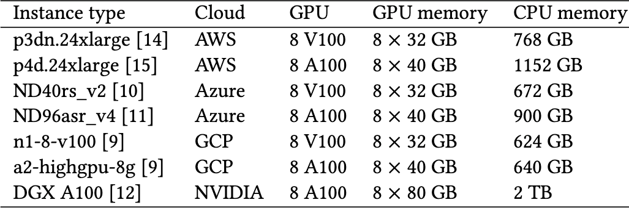
Gemini
Checkpoint to CPU memory
CPU memory is much larger than GPU memory
CPU memory size is sufficient to store checkpoints

Slide 58
Gemini
Checkpoint to CPU memory
CPU memory is much larger than GPU memory
Checkpoint to CPU memory enables a much higher frequency
Low ^{Bandwidth}
High Bandwidth
Remote storage
Checkpoint to remote storage
Checkpoint to CPU memory
GPU
Machine
CPU memory
Checkpoint

Slide 59

Gemini
Checkpoint to CPU memory
CPU memory is much larger than GPU memory
Checkpoint to CPU memory enables a much higher frequency
CPU memory only stores checkpoints for failure recovery
Decouple the checkpoints for different purposes
Failure recovery
Debugging, accuracy evaluation
High-frequent checkpoints
Only need the latest one
Need checkpoint history
Low-frequent checkpoints
CPU memory
Remote storage

Slide 60
Gemini
Architecture
Two modules
Checkpoint creation module
Worker
agent
Worker
agent
Remote storage
Worker
agent
GPU
Machine
Checkpoint

Slide 61
Gemini
Architecture
Two modules
Failure recovery module
Checkpoint creation module
Worker
agent
Distributed key-value store
Worker
agent
Remote storage
Cloud operator
Worker
Root
agent
agent
GPU
Machine
Checkpoint
Health status
Machine replacement

Slide 62
Challenge #1
Data stored in CPU memory can get lost

Slide 63
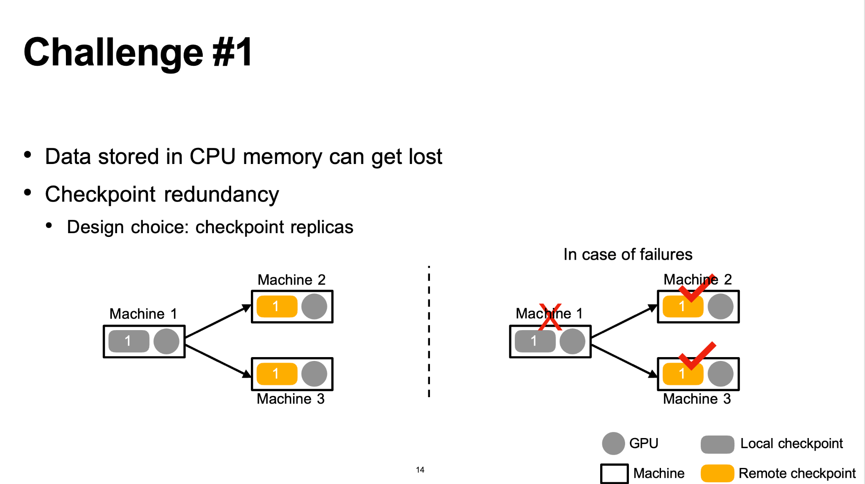

Slide 64
Challenge #1
Optimal checkpoint placement
Data stored in CPU memory can get lost
Solution: checkpoint redundancy
Design choice: checkpoint replicas
Maximize the probability of failure recovery from checkpoints stored in GPU Memory
1

Slide 65
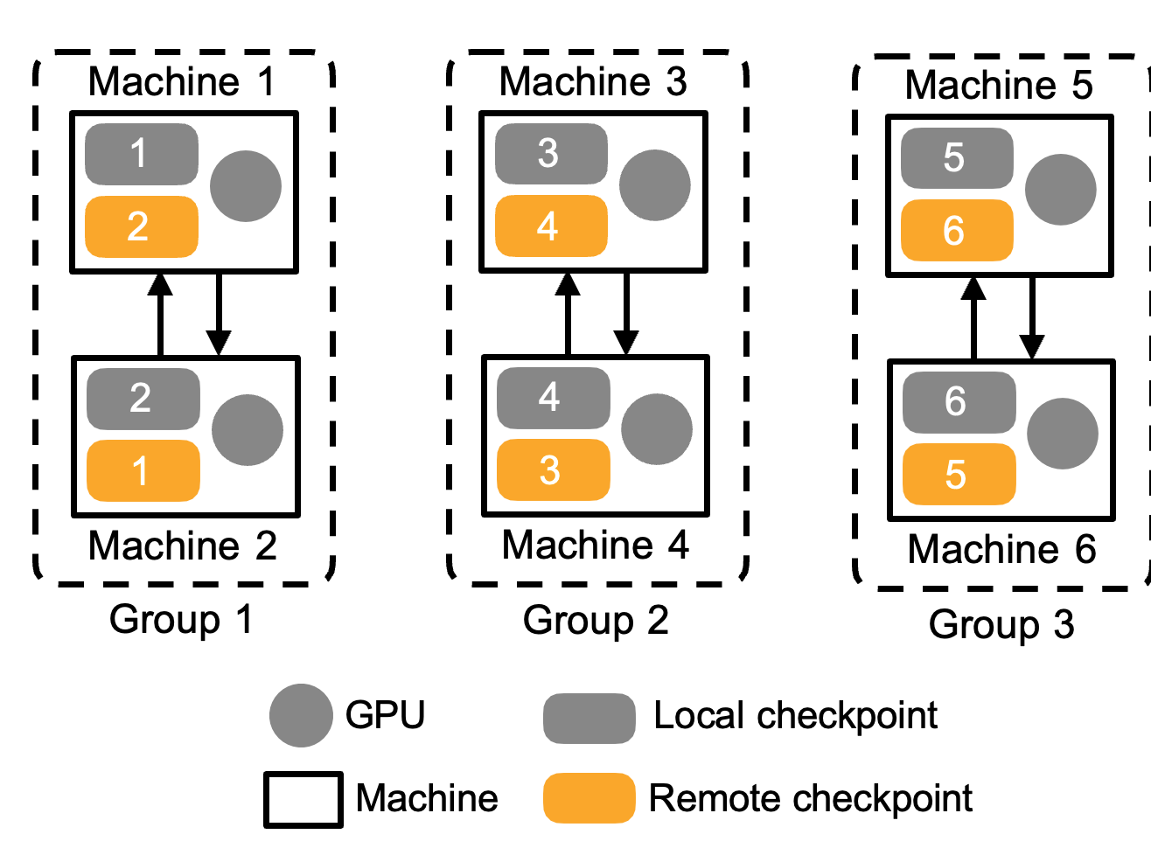
Solution
Group placement strategy
Two steps
An example with two replicas
Given m replicas, all machines are divided into disjoint groups and each group has m machines
Each machine backups a checkpoint replica for all machines within the same group

Slide 66
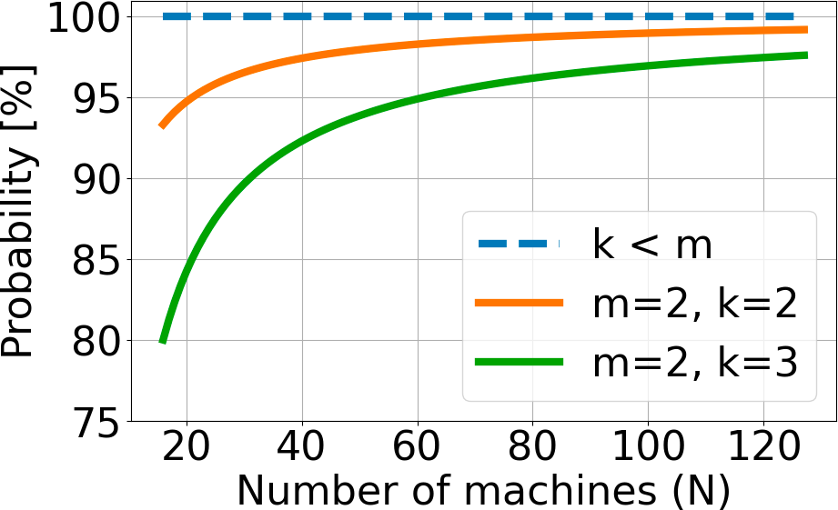
Solution
Group placement strategy
m: # of checkpoint replicas k: # of failures machines
93%
Two steps
Given m replicas, all machines are divided into disjoint groups and each group has m machines
Each machine backups a checkpoint replica for all machines within the same group
80%
Group placement strategy is provably optimal
Two checkpoint replicas can already handle most failure cases!

Slide 67
Challenge #2
Checkpoint traﬃc interferes with training traﬃc
Checkpoint to remote storage
Checkpoint traffic and training traffic have different networks
Remote storage
GPU
Machine
Checkpoint
Training traﬃc

Slide 68
Challenge #2
Checkpoint traﬃc interferes with training traﬃc
Checkpoint to CPU memory
Checkpoint traffic and training traffic
shares the same network
It can harm training throughput
Remote storage
GPU
Machine
Checkpoint
Training traﬃc

Slide 69
Solution
Traﬃc interleaving
Observation: Idle timespans in the network
Computation
Training traﬃc
Communication
(a) Baseline
Time
Idle timespans

Slide 70
Solution
Traﬃc interleaving
Insert checkpoint traﬃc in idle timespans
Computation
Training traﬃc
Communication
Checkpoint traﬃc
(a) Baseline
Time
Computation
Communication
No overhead compared to Baseline
Checkpoint
(c) Interleaving
Time

Slide 71
Out-of-memory issue
GPU memory is mainly used for training
Limited spare GPU memory for checkpoint traﬃc
Training traﬃc
(a) Baseline
X
Time
How to minimize the extra GPU memory consumption?
Sender
GPU
X
Time
GPU
CPU
Receiver
(b) Out of memory

Slide 72
Our design
Checkpoint partition and pipelining
Keys ideas
Training traﬃc
•
•
Reserve a GPU buﬀer at the receiver Partition the buﬀer to multiple sub-buﬀers
(a) Baseline
Time
Sender
GPU
Time
GPU
1
2
Receiver
CPU
(c) Gemini

Slide 73
Our design
Checkpoint partition and pipelining
Keys ideas
Training traﬃc
•
•
•
Reserve a GPU buﬀer at the receiver Partition the buﬀer to multiple sub-buﬀers Pipeline checkpoint communications
(a) Baseline
Time
Sender
GPU
Time
GPU
1
2
Receiver
CPU
(c) Gemini

Slide 74
Design
Checkpoint partition and pipelining
Keys ideas
Training traﬃc
•
•
•
Reserve a GPU buﬀer at the receiver Partition the buﬀer to multiple sub-buﬀers Pipeline checkpoint communications
(a) Baseline
Time
The GPU sub-buffers are reused
Sender
GPU
Time
GPU
1
2
1 | 2 | 1 | 2 | 1 | 2
A small GPU buffer, e.g., 128MB, is sufficient
1
2
Receiver
CPU
(c) Gemini

Slide 75
Resume training from failures
Software failures
Checkpoints are available at local
Machine 1
1
2
Negligible retrieval time
2
1
4
3
Just few iterations are lost
Machine 2
Machine 4
3
4
Local checkpoint Remote checkpoint
Machine 3
29

Slide 76
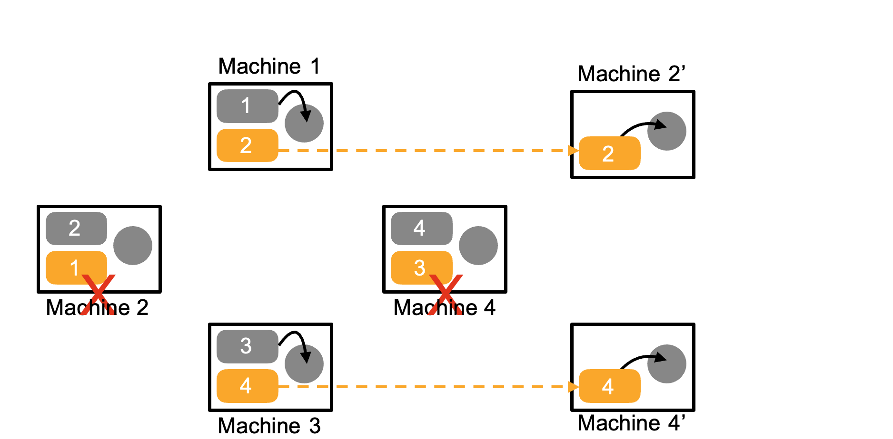
Resume training from failures
Hardware failures
Checkpoints are still available at other machines

Slide 77
Evaluation
Settings
Framework: DeepSpeed, ZeRO-3
16 p4d instances (128 A100 GPUs), 400Gbps network bandwidth
The aggregated bandwidth of remote storage: 20Gbps
The size of LLM: 100 billion parameters
Reserved GPU buﬀer size: 128MB

Slide 78
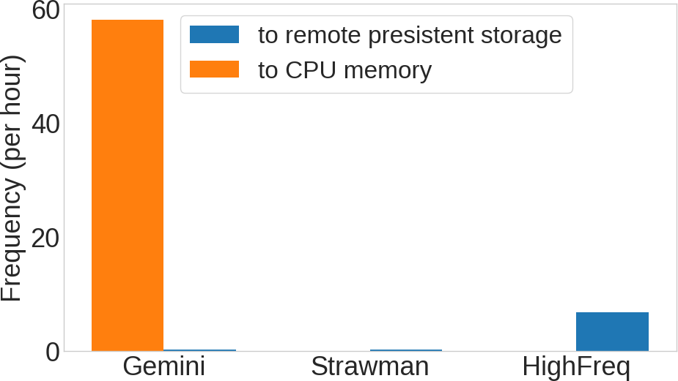
Checkpoint frequency
Baselines
•
•
Strawman: every 3 hours (BLOOM’s frequency ^{[1]}) HighFreq: saturate the remote storage bandwidth capacity
170X
8X
Gemini: Checkpoint model states every iteration
[1] Bloom: A 176b-parameter open-access multilingual language model. arXiv preprint arXiv:2211.05100

Slide 79
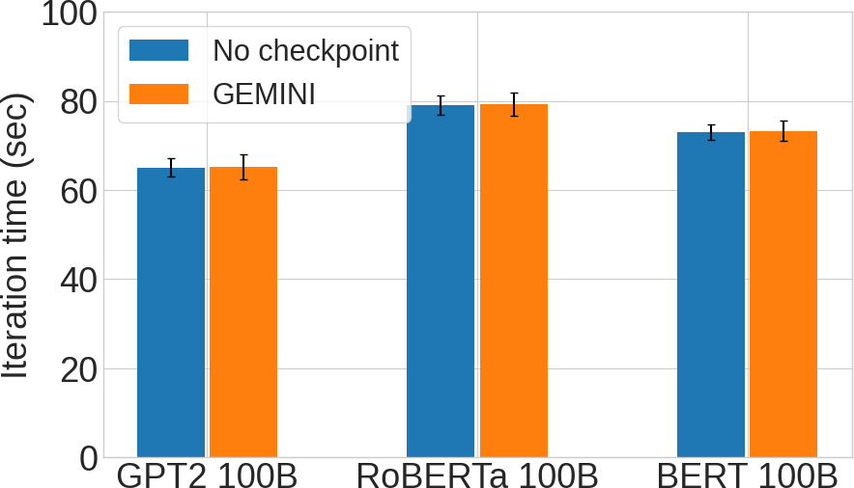
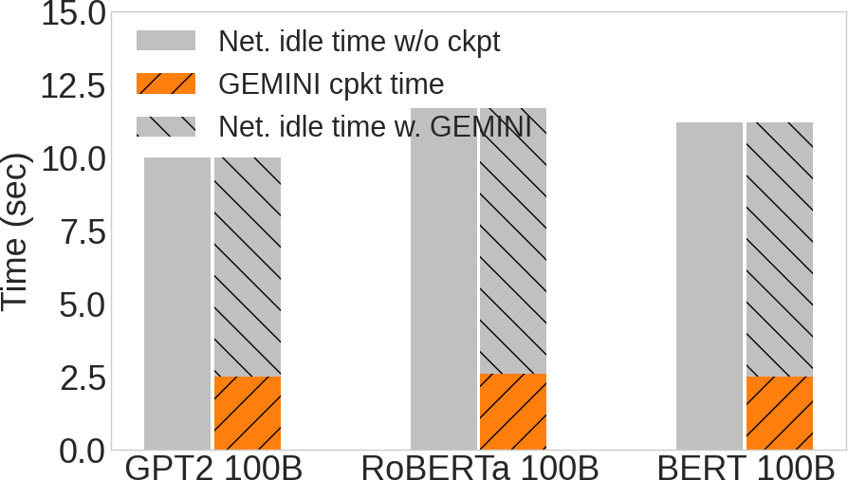
Training efficiency
Training time
Gemini checkpoints model states to CPU memory every iteration
Negligible overhead on iteration time
Idle timespans can accommodate checkpoint traffic

Slide 80
Summary
Large model training suﬀers from frequent failures
Gemini checkpoints model states to CPU memory for failure recovery
Optimal checkpoint frequency, i.e., every iteration
Negligible overhead on training throughput
Applicable to diﬀerent parallelism strategies of training

